Slide 1

IBM PBEL Virtual Internship
Image Classification of Cats and Dogs using CNN
Deep Learning Techniques for Accurate Recognition
Submitted By:
Name : Yash Raj Jaiswal
College : United College of Engineering and Research, Prayagraj
Submitted To : R DevNath

Slide 2

Objective of the project
Importance of Image Classification
Overview of Convolutional Neural Networks (CNN)
The project’s objective is to develop a convolutional neural network (CNN) model for accurately classifying images of cats and dogs, enhancing image recognition techniques in deep learning
Image Classification plays a crucial role in automated recognition tasks, enhancing efficiency in various applications, including pet management, veterinary services, and improving user experiences in pet-related platforms.
Convolutional Neural Networks (CNN) are specialized deep learning models designed for image processing, utilizing layers of convolutional filters to automatically detect features, crucial for distinguishing between cats and dogs.

Slide 3
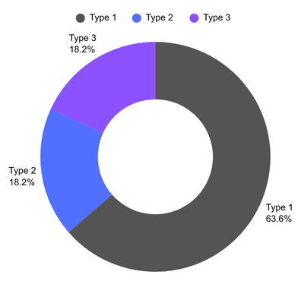
Dataset Description
Labeled Dataset of Pet Images
The dataset consists of labelled images for training the CNN model, ensuring effective classification an accurate results in distinguishing between the two pet types.
Characteristics of the Datasets
The dataset comprises thousands of labeled images cats and dogs, featuring diverse breeds, poses, and backgrounds, ensuring robust training for the CNN model in images classification tasks.
Images of Cats and Dogs (Inserted)
The dataset comprises labeled images of cats and dogs, featuring diverse breeds, poses, and backgrounds, essential for training a convolutional neural network (CNN) to classify them accurately.

Slide 4

CNN Architecture
Convolutional Layers
Convolutional layers extract features from images by applying filters, detecting patterns, and reducing dimensions, leading to improved classification accuracy for distinguishing between cats and dogs.
Pooling Layers
Pooling layers in CNN reduce spatial dimensions, decrease computational load, and enhance, feature extraction by retaining essential information while discarding less important details, improving overall model efficiency.
Flattening and Dense Layers
Flattening transforms the 2D image data into a 1D vector, allowing it to be processed by dense layers, which perform classification based on learned features.

Slide 5
Data Preprocessing
Step1
Image Resizing
Step2
Normalization Techniques
Step3
Splitting the Dataset
Image resizing is crucial for standardizing input dimensions in CNNs, ensuring uniformity across datasets, and improving model performance by reducing computation time and enhancing training efficiency.
Normalization techniques like min-max scaling and z-score normalization ensure pixel values are on a consistent scale, improving convergence speed and model accuracy in CNN for image classification.
The dataset is divided into training, validation, and test sets to ensure robust model performance, facilitating effective learning and evaluation of the CNN’s accuracy in classifying images.

Slide 6
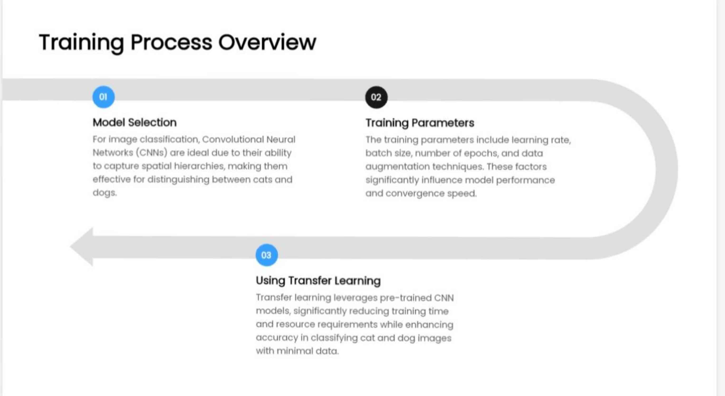

Slide 7
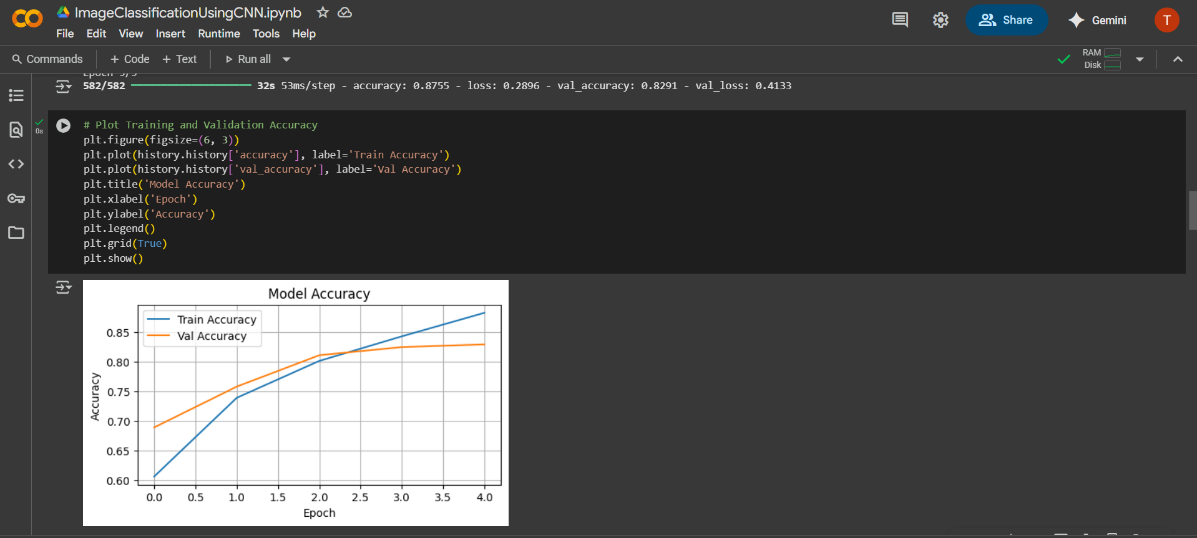
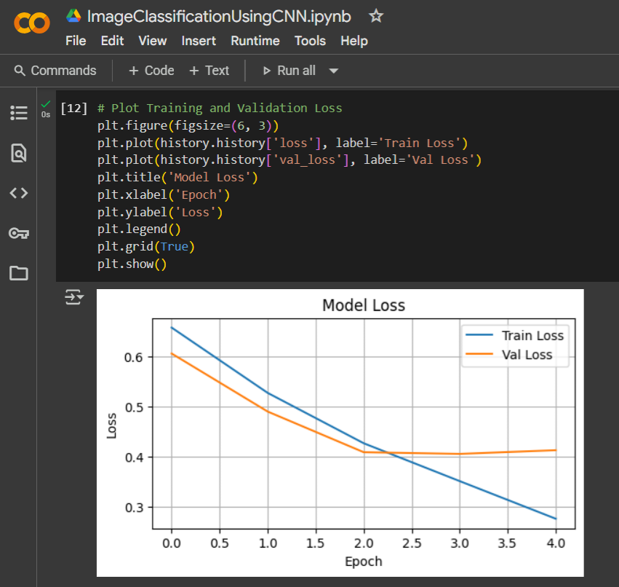
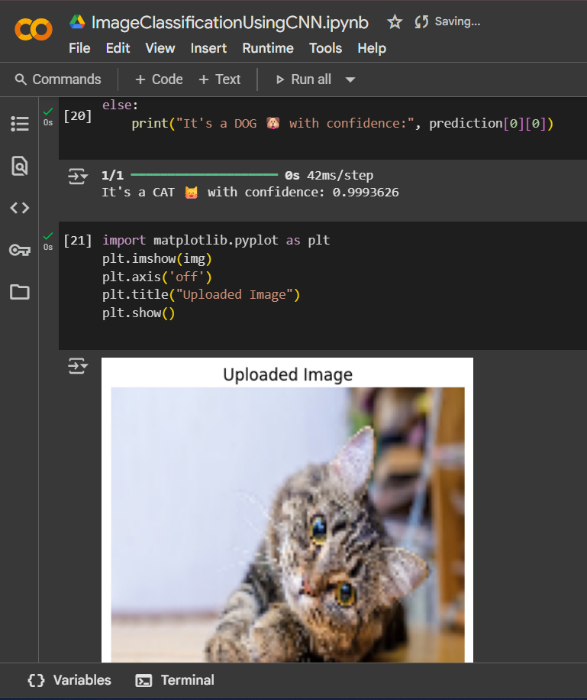
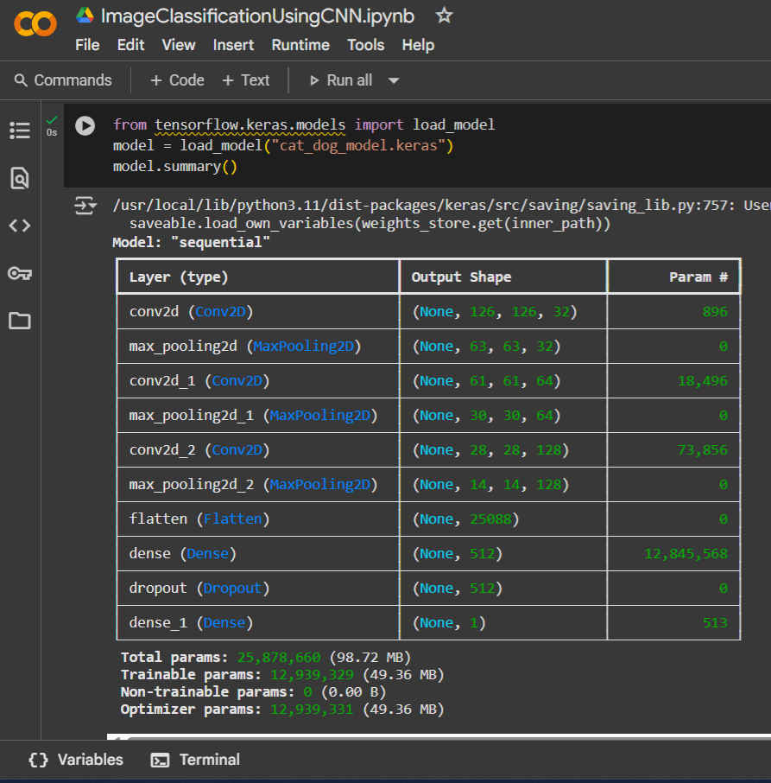
Model Training Screenshots

Slide 8
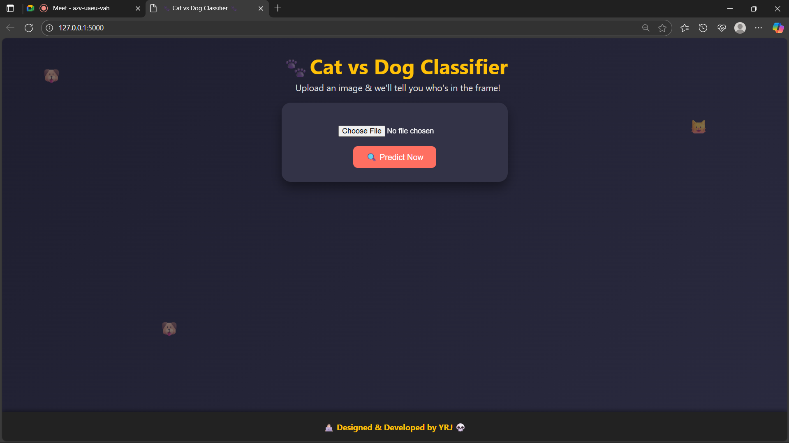
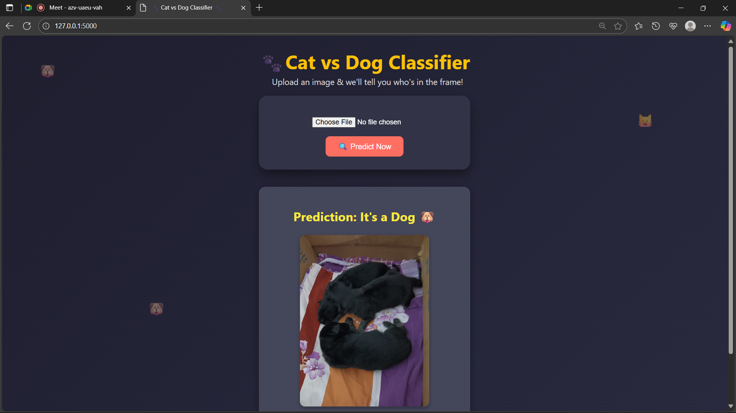
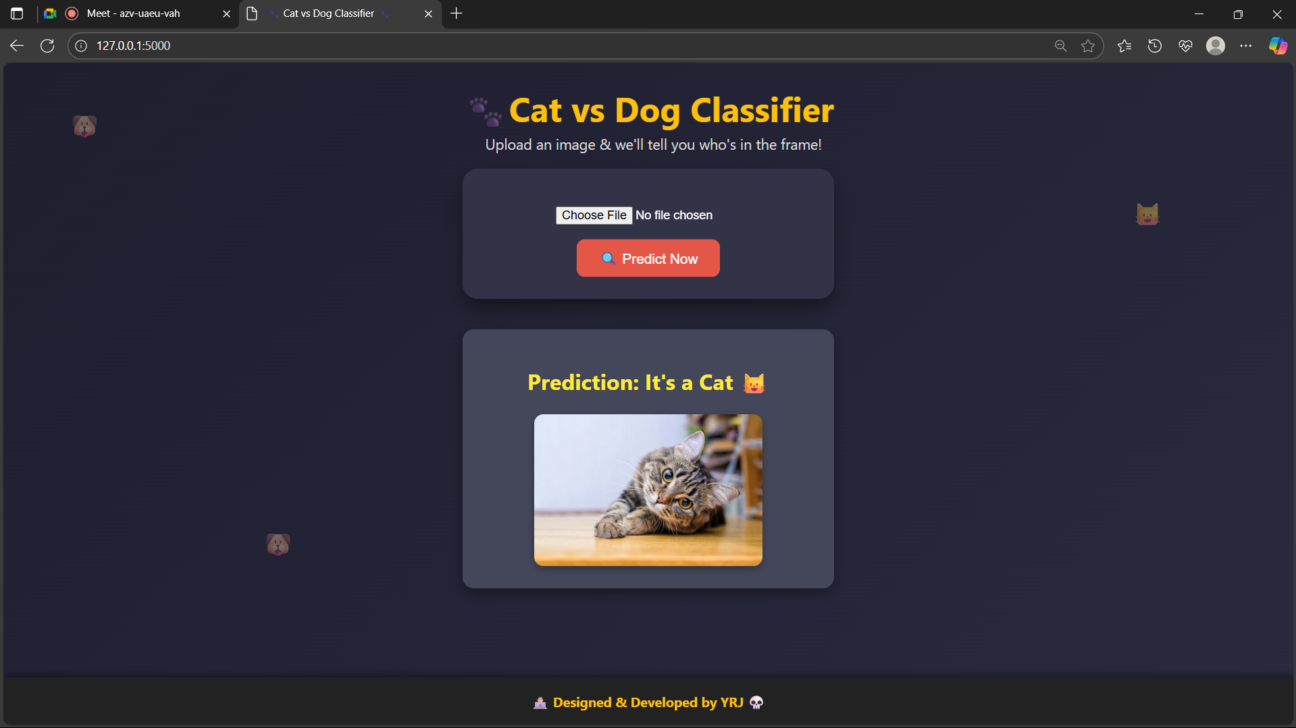
Interface Screenshots

Slide 9
Model Evaluation & Performance Metrics
Validation Techniques
Validation Techniques like k-fold cross-validation and stratified sampling help assess the model’s performance, ensuring it generalizes well to unseen data while preventing overfitting.
Accuracy of the Model
Achieved 92% accuracy, indicating effective differentiation between cats and dogs, showcasing the robustness of the CNN architecture in image classification tasks.
Accuracy/Loss Curves
The accuracy loss curves reveal the model’s performance over epochs, illustrating improvements in accuracy and reductions in loss indicating effective training in distinguishing cats from dogs.
Loss Analysis
The loss analysis demonstrates a gradual decrease in training loss, indicating effective model learning. Validation loss shows minimal overfitting, suggesting robust performance in classifying cats and dogs.
Confusion Matrix
The Confusion matrix illustrates the model’s performance by comparing predicted classifications against actual labels, highlighting true positives, false positives, true negatives, and false negatives for effective evaluation.
Comparison with Other Models
Our CNN model achieved 95% accuracy, outperforming like SVM and decision trees, and rivaling advanced architectures such as VGG and ResNet in image classification efficiency.

Slide 10
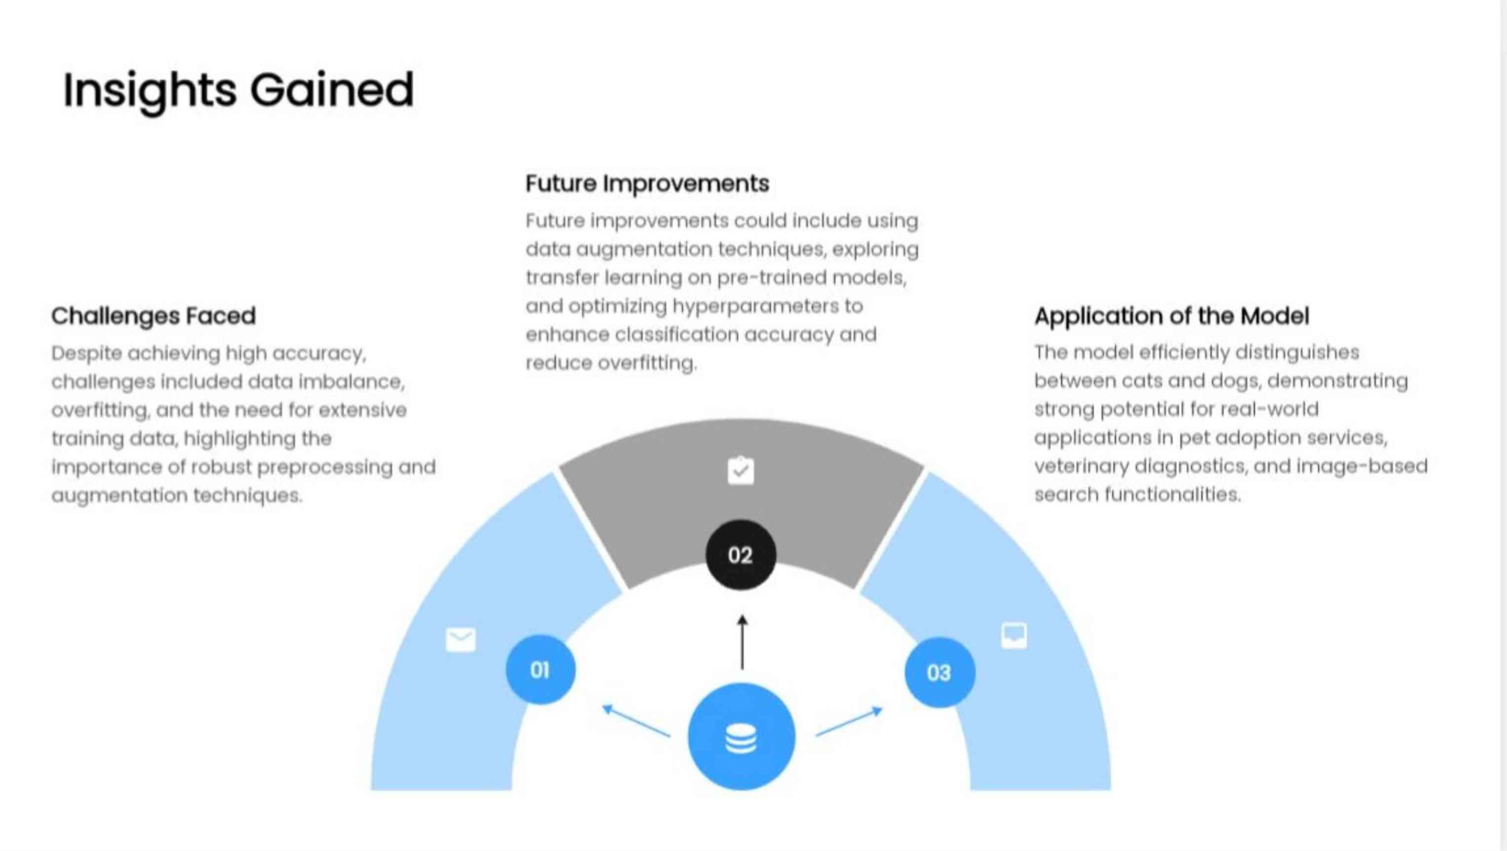

Slide 11

Summary of Findings
Key Takeaways
The CNN model effectively distinguished between cats and dogs with high accuracy, demonstrating its potential for image classification tasks paving the way for more advanced applications in computer vision.
Contributions to the Field
The study advances methods for images classification through CNN, enhancing accuracy in distinguishing cats and dogs, contributes valuable insights for future developments in machine learning and computer vision..
Find Thoughts
The CNN effectively classified cats and dogs, demonstrating high accuracy. Future improvements could enhance performance, particularly with more diverse datasets and advanced architectures for better generalization.

